Slide 1
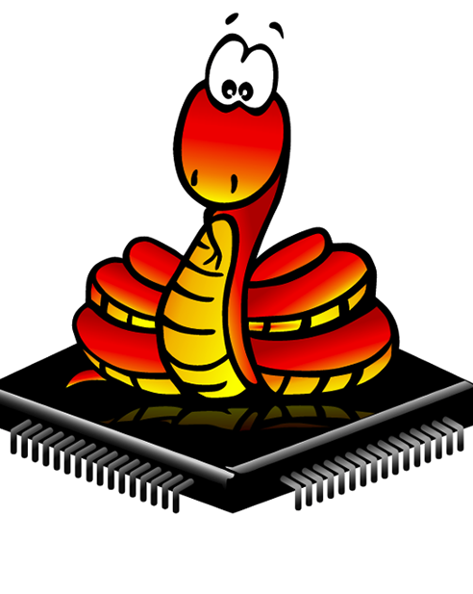
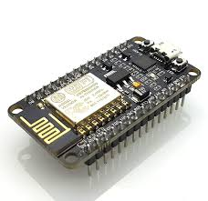

Micropython With ESP8266
for the Internet of Things

Slide 2
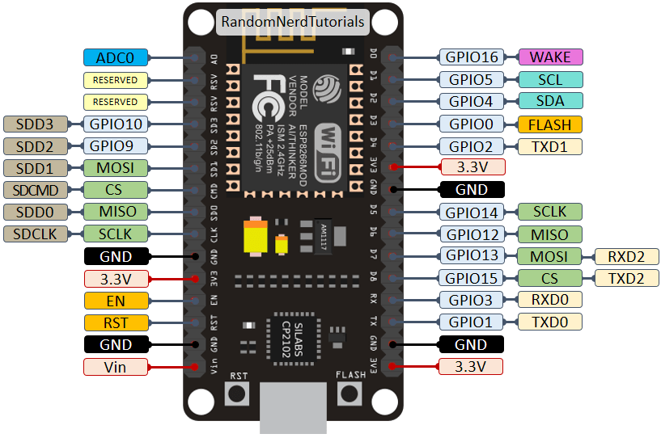
1- There is a single frequency for all channels, with range between 1 and 1000 (measured in Hz).
2- The duty cycle is between 0 and 1023 inclusive.

Slide 3
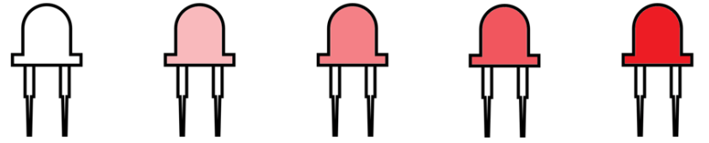
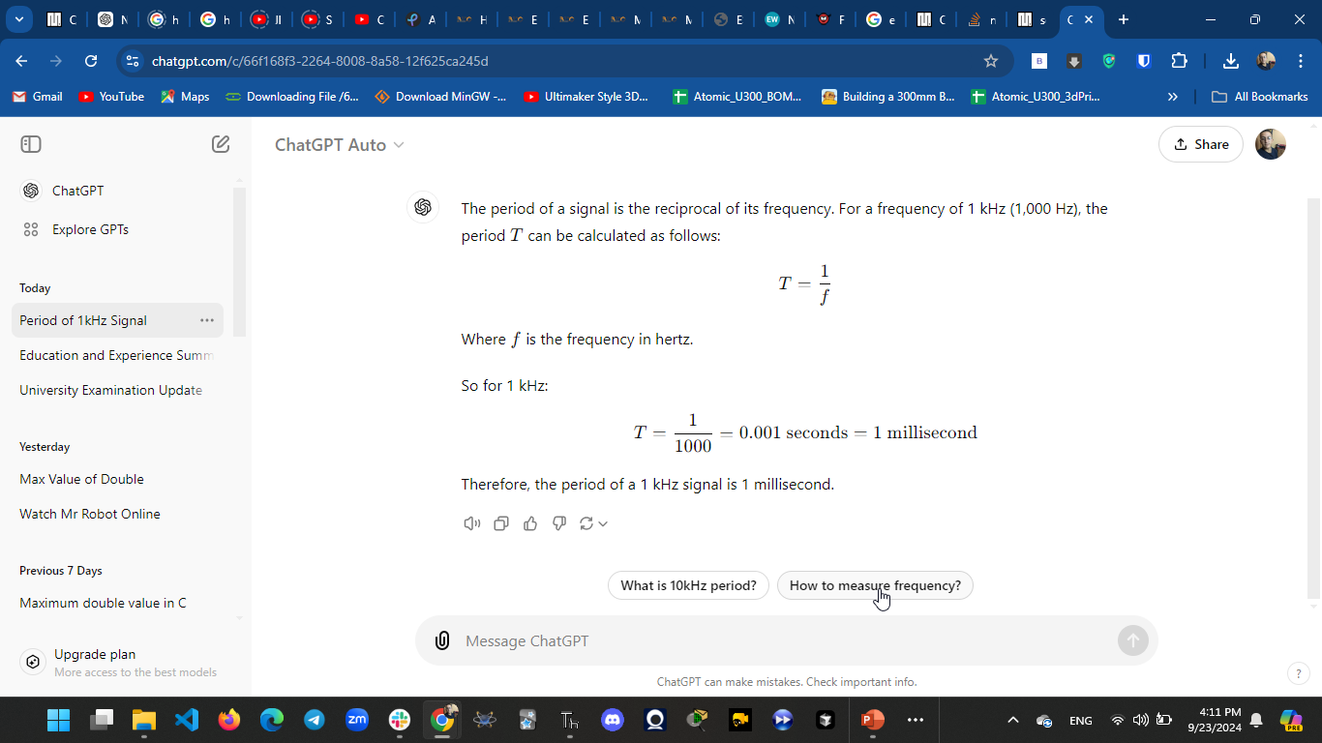






(20/ 50) * 100 = 20 %

Slide 4
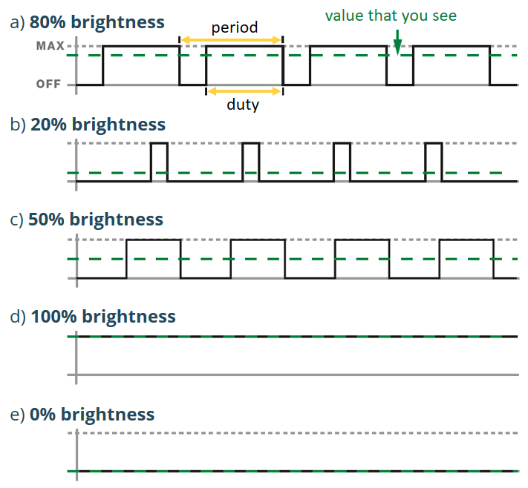







Slide 5
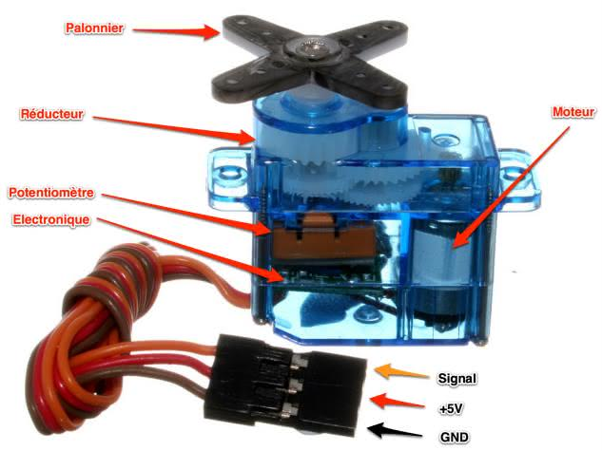
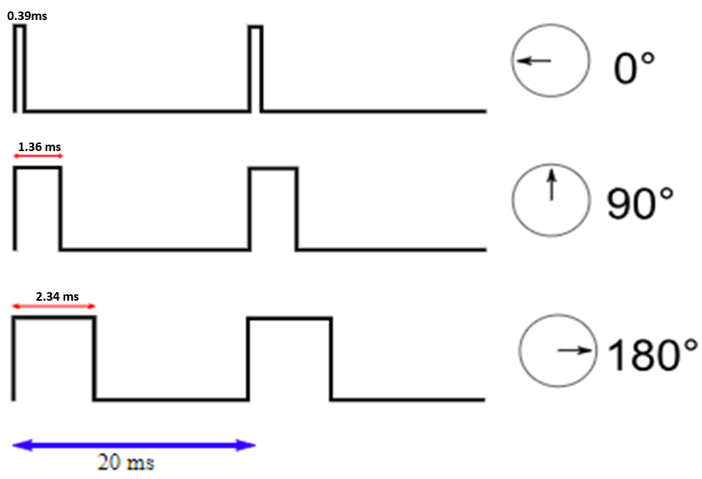













Slide 6
THANK YOU

